Slide 1
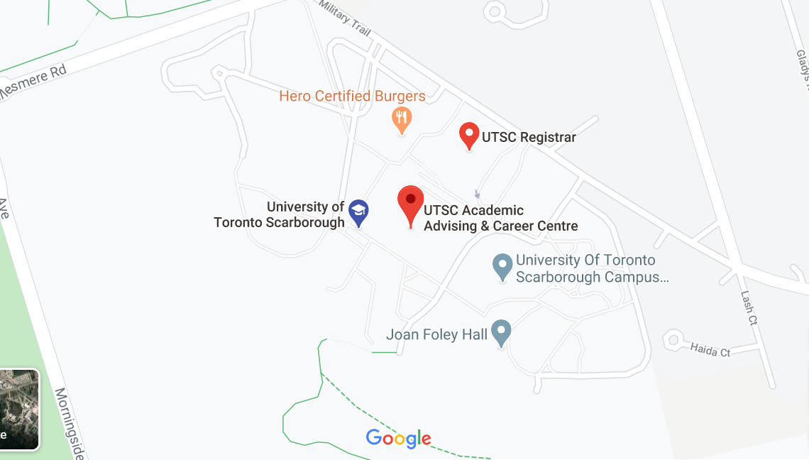

OnTime
Co-Founders
Sheeza Aziz
Osman Amjad
Jawad Jawid
Not Earlier, Nor Later
Sumuhash Mannogaran
Riyasat Talukder
Jenisha Thomas
Notes:
(Everyone introduces themself)
Introducing OnTime! An app designed to help people like you find the hospitals and clinics with the shortest waiting times, to get you the healthcare you need, when you need it!
Now you may be wonder, how did we come up with such an AMAZING idea? Let take a trip back in time and see how OnTime came to be.
Here are our co-founders
https://www.figma.com/file/emWIfJQTsqAGe8Kj0EeBDZ/OnTime-Updated-for-A7b

Slide 2
How did we arrive to our app idea?
Notes:
NOTE: Audio clip icon in top right corner

Slide 3
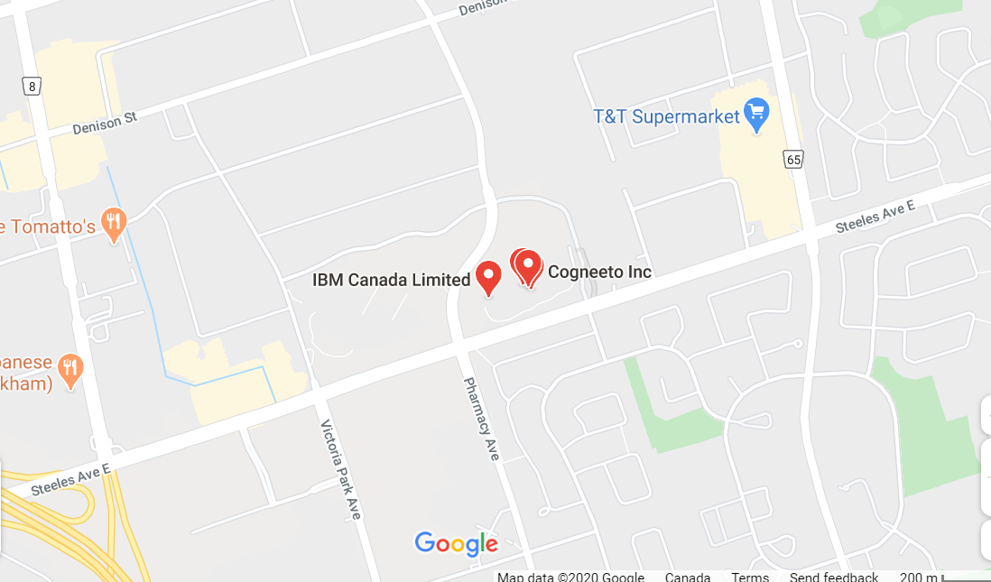
Problem Space
May 19, 2020
Our Problem Space
Access to the Canadian Healthcare System
Our Motivation
Receiving medical attention immediately when required
Finding flaws within a well developed healthcare system
Notes:
- The problem space that we decided to choose is access to Canadian health care
- Our motivation behind choosing this is to provide patients with a tool that will help them get medical attention with little to no barriers, especially during this pandemic.
- We also want to investigate deeper into our well developed health care system and find any flaws that lie within it

Slide 4
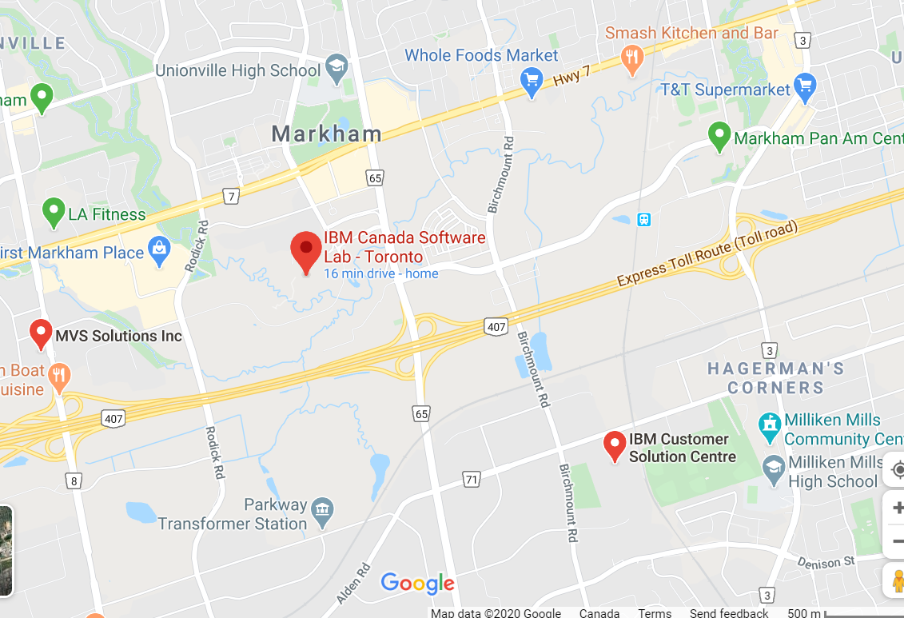
User Needs Analysis
May 19, 2020
Our Research Method Process
Identified target audience
Identified individuals who face barriers in accessing healthcare
Conducted primary and secondary research on the individuals identified
Conducted interviews with healthcare workers for an insider’s perspective
Notes:
SHEEZA: After finding our problem space of “access to healthcare” we wanted to narrow our problem down to a specific problem. So we began our research by first identifying our target audience, which we realized encompasses all canadians because all canadians need access to healthcare. So, to make our research more effective we broke down our target audience and identified individuals who face more barriers than others in accessing healthcare. We identified elderly, and individuals in lower education and lower income levels to be the focus of our research, and then we began to conduct primary and secondary research on these individuals. We also wanted to get an insider’s perspective on the system so we conducted interviews with healthcare workers

Slide 5
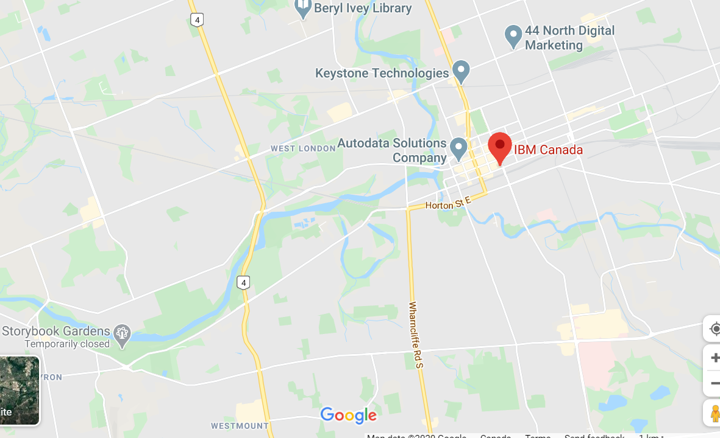
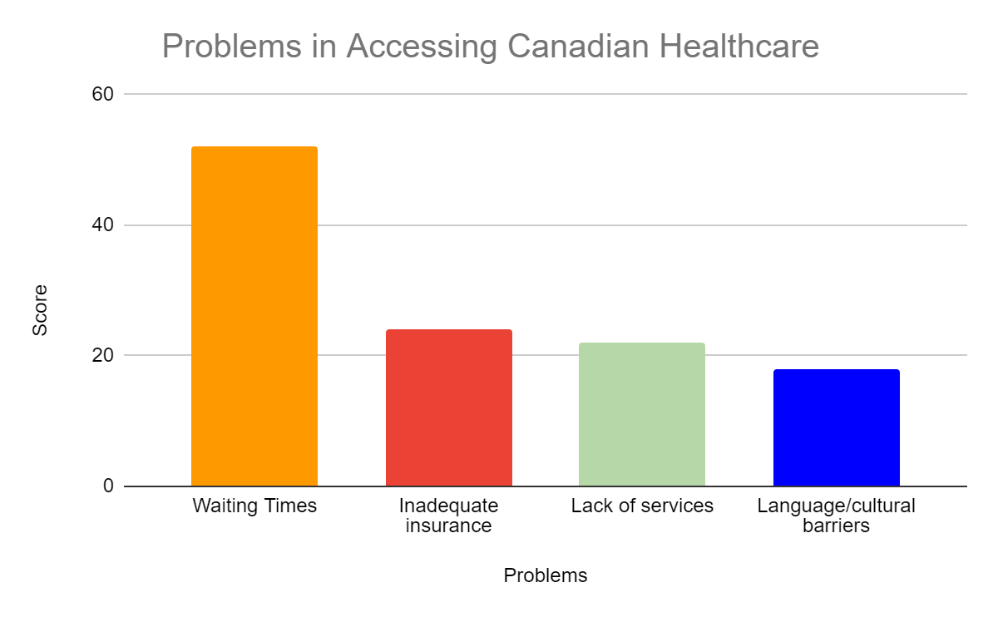
User Needs Analysis
June 3, 2020
Primary Research (Survey) Findings 60 participants
Notes:
Mention that we surveyed around 60 people
healthcare

Slide 6
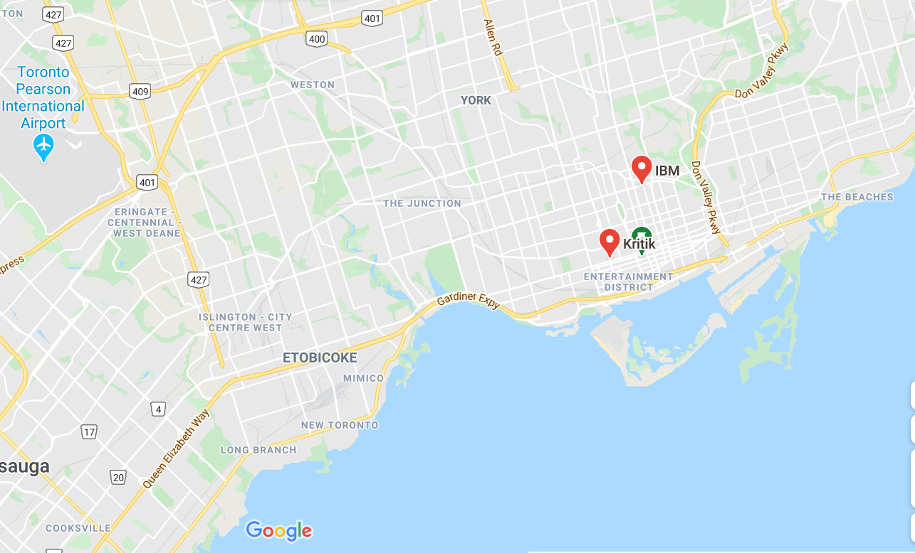
User Needs Analysis
June 3, 2020
Primary Research (Interview) Findings
“I think wait times would be the biggest factor. A lot when you go to the hospital, like you have to wait for hours and hours and hours. And I feel like patients don't really want to wait they want to be in and out.” - Hospital Volunteer
“Wait times are always a huge thing that people complain about that comes back just like supply of physicians, nurses, just the healthcare field in general.” - Maternity Ward Nurse

Slide 7
How did we arrive to our final prototype?
Notes:
After completing our user needs analysis, we each went off and made our individual low fi prototypes of what we thought would be the the best design for our system. Following this we performed some individual usability tests, and made changes according to the results. Once we each applied our findings to our prototypes and completed our second iteration of low fi prototypes, we all came together to discuss our combined prototype.

Slide 8
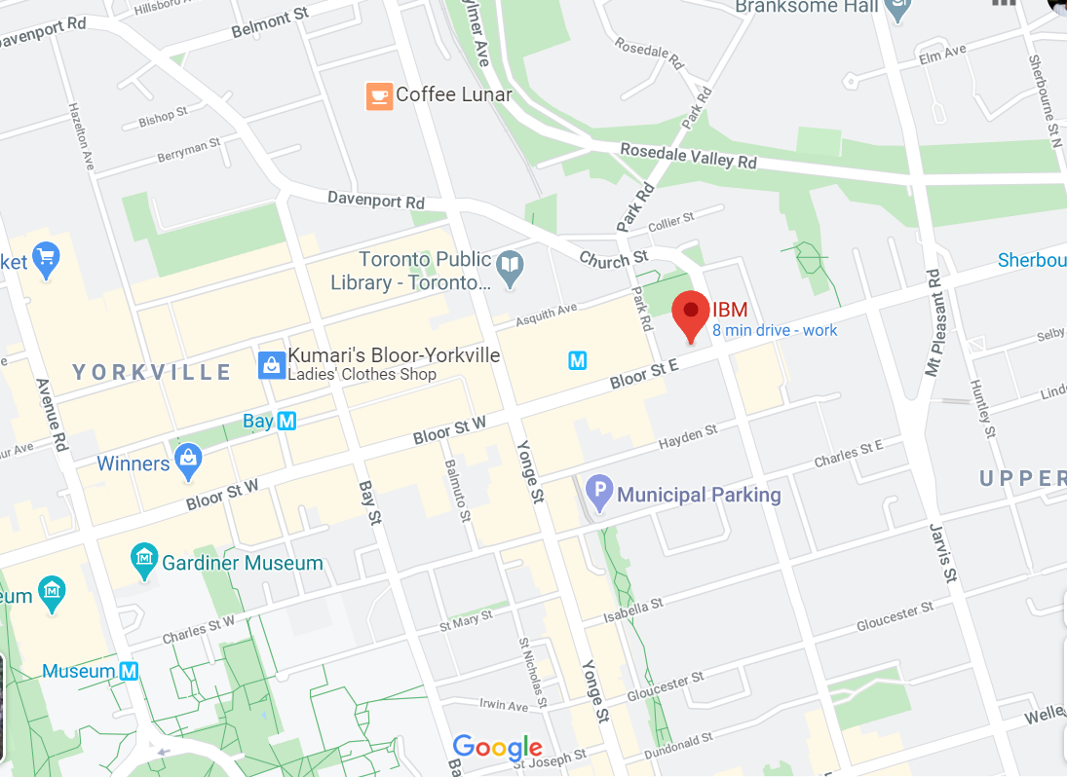
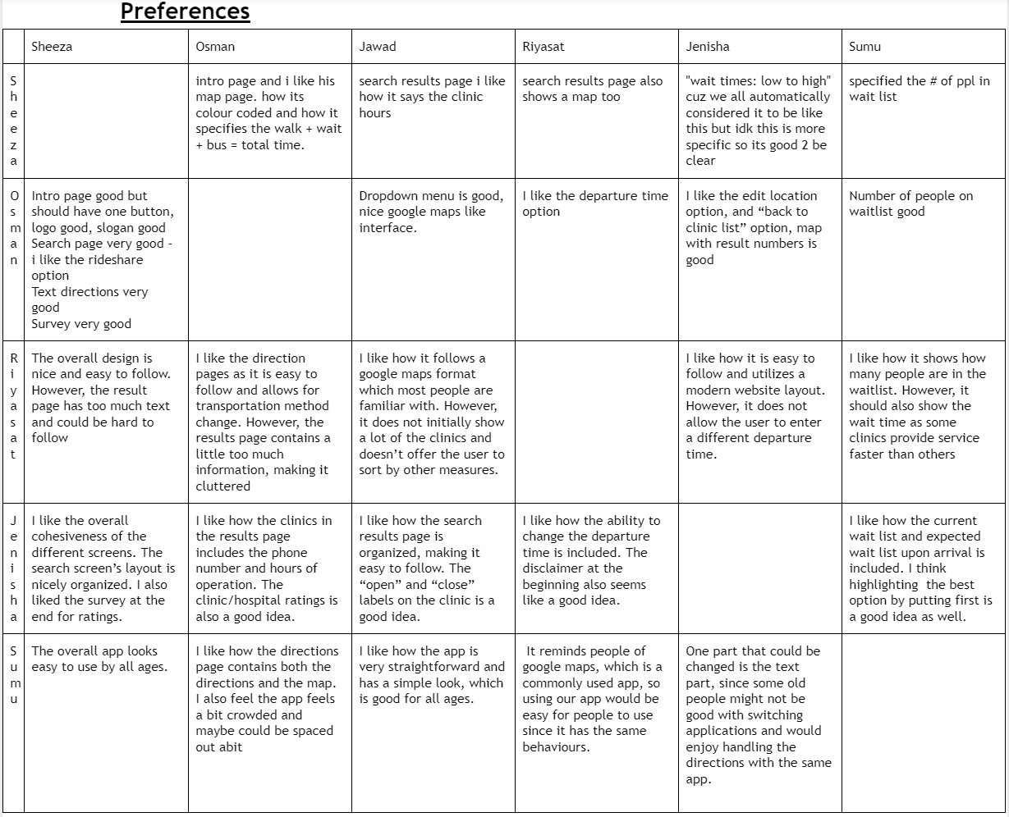
Iterative Design
July 7, 2020
Individual Prototype Analysis Table
Notes:
Individual prototypes of what we think the design of the system should look like
Shared the prototypes with the group
Received feedback on what we like about each others prototype

Slide 9
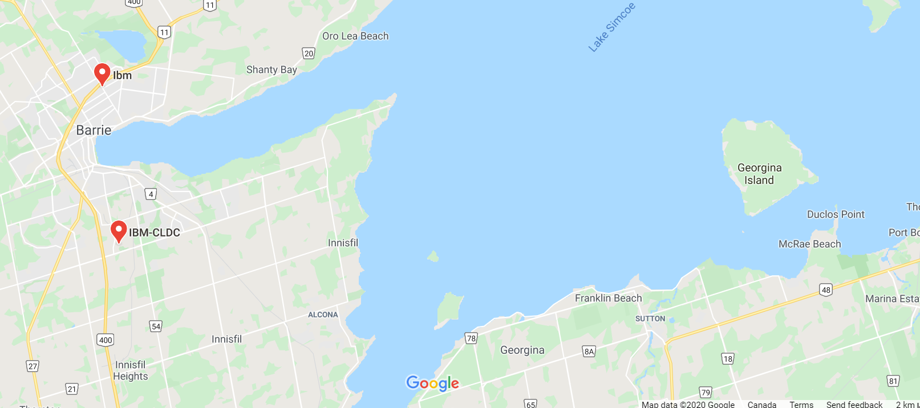
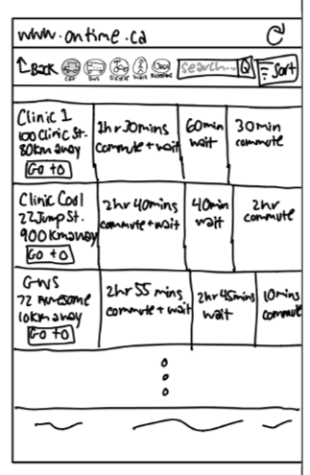
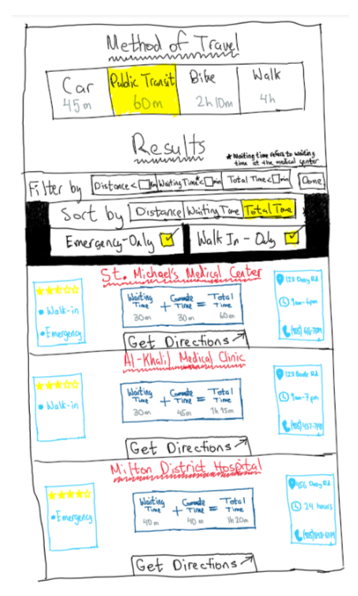
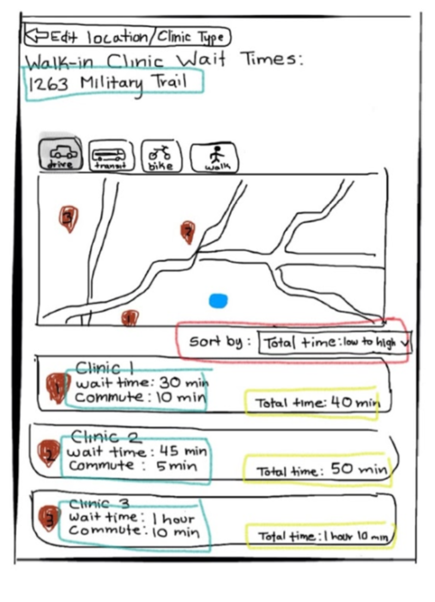
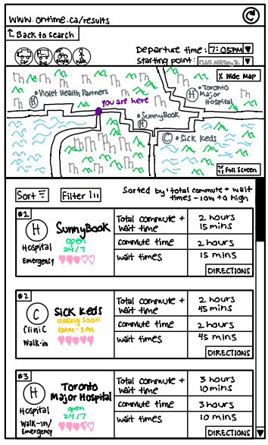
Iterative Design
July 7, 2020
From individual Low-fi Prototypes to Combined Low-fi Prototype

Slide 10
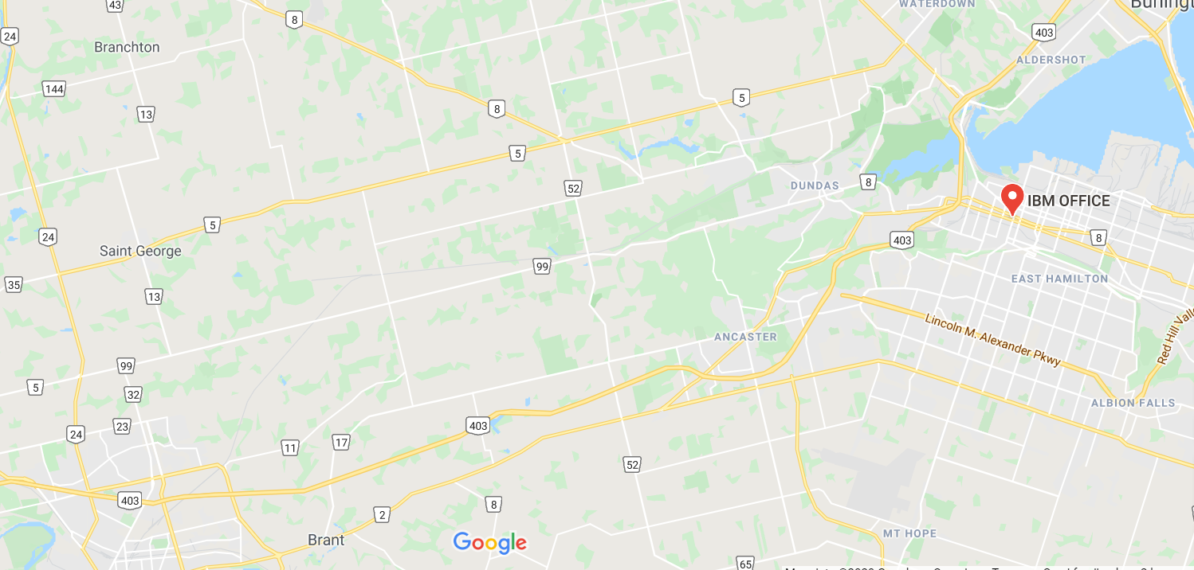
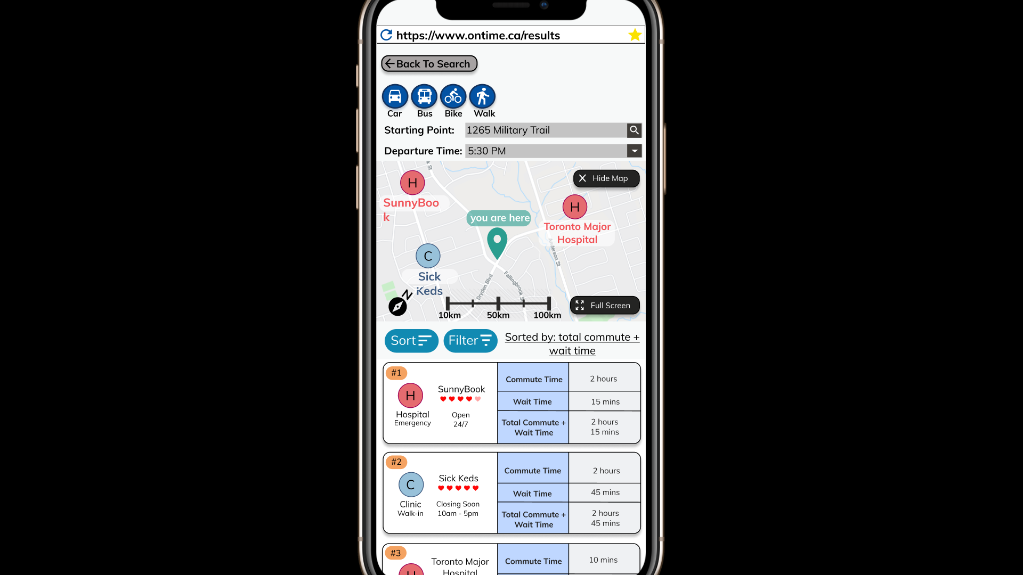
Iterative Design
July 19, 2020
From Combined Low-fi Prototype to Hi-fi Prototype
Based off of Nielsen’s 10 Heuristics for User Interfaces
Notes:
After combining our individual prototypes, we performed a heuristic analysis on the combined prototype, and utilized our findings to create our final Hi-Fi prototype

Slide 11
What did our users think?
Notes:
After completing our user needs analysis, we each went off and made our individual low fi prototypes of what we thought would be the the best design for our system. Following this we performed some individual usability tests, and made changes according to the results. Once we each applied our findings to our prototypes and completed our second iteration of low fi prototypes, we all came together to discuss our combined prototype.

Slide 12
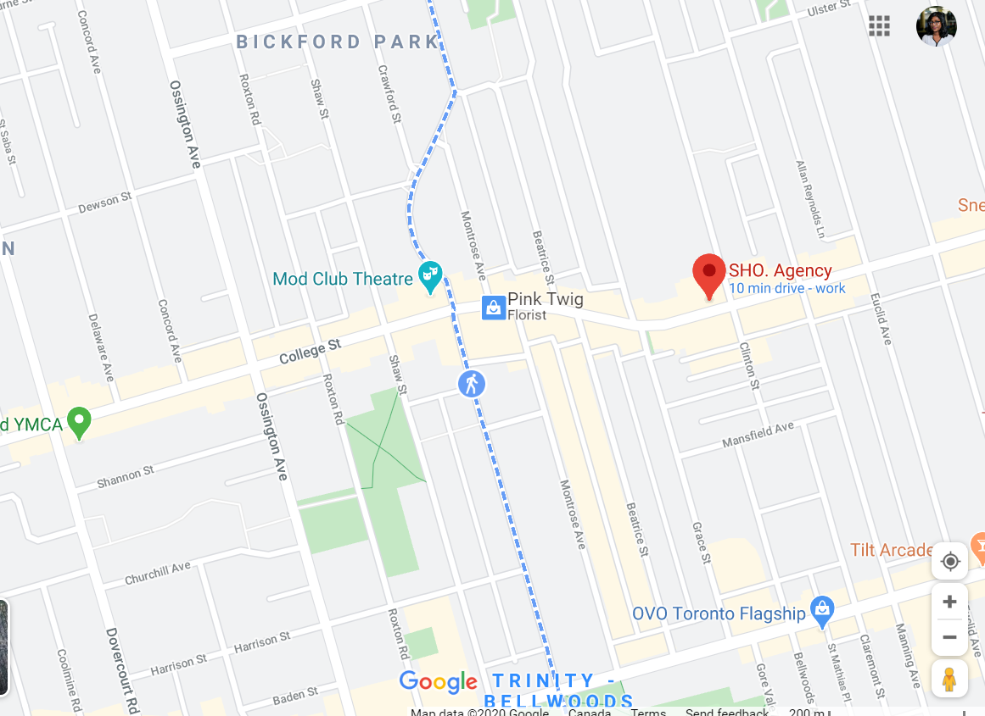
Pilot Testing Feedback
July 20, 2020
Positives
Useful and easy to understand
Sorting and filtering options
Similar interface to google maps
Getting directions by SMS
Criticism
Font/Button size
Certain components crammed together
Notes:
After we finished our high-fi prototype, we did some pilot testing and the feedback we got were some pos and neg
Criticism: font size smaller and icon are small

Slide 13
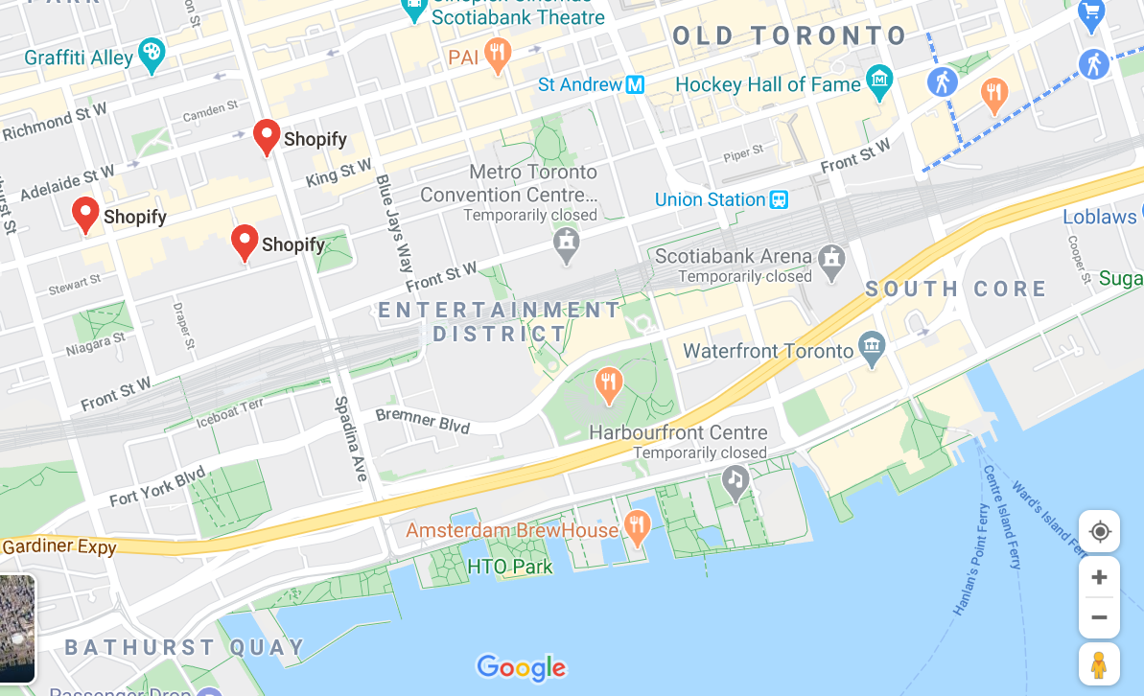

Pilot Testing Feedback
August 4, 2020
Example Task Completion
Notes:
make sure to lower the volume

Slide 14
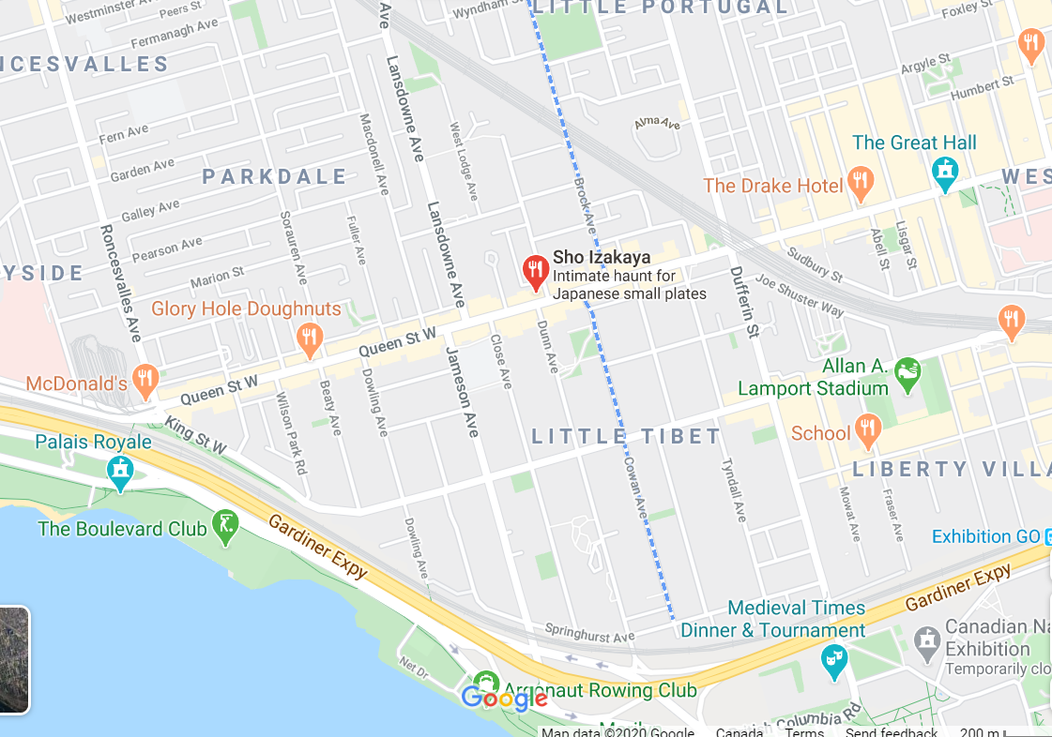
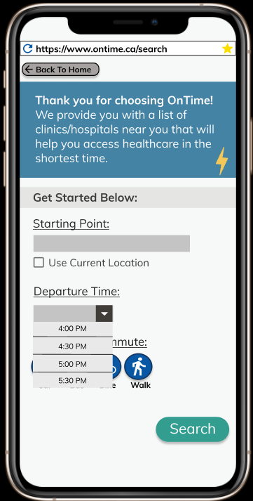
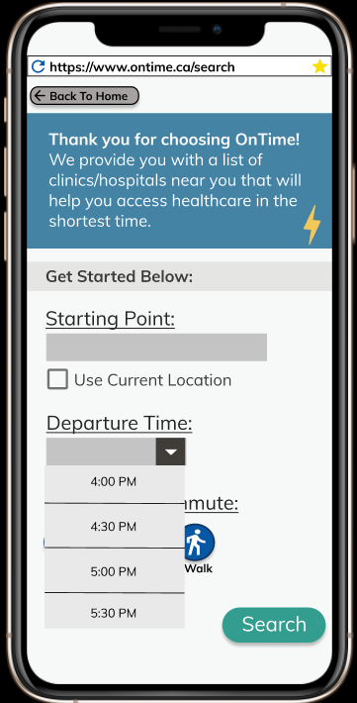
Pilot Testing Feedback
August 4, 2020
Improvements
Notes:
Text got bigger, button got bigger, we used more of the space

Slide 15
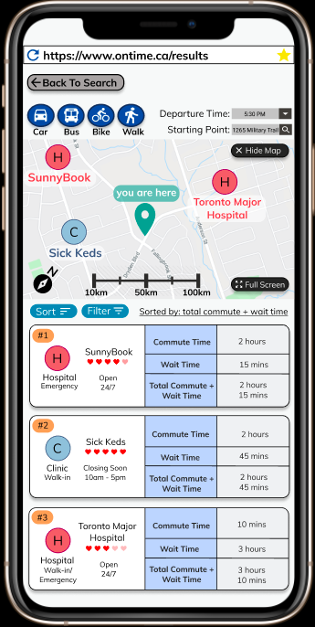
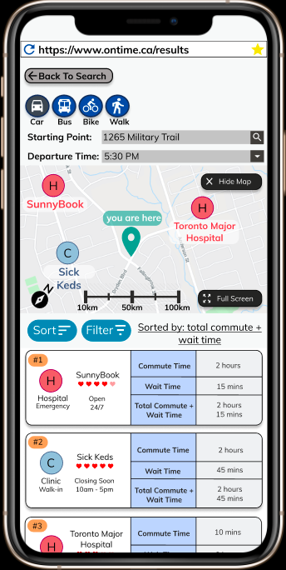
Pilot Testing Feedback
August 4, 2020
Improvements
Notes:
Similarly, we also made the same changes here and we also made a scroll feature

Slide 16
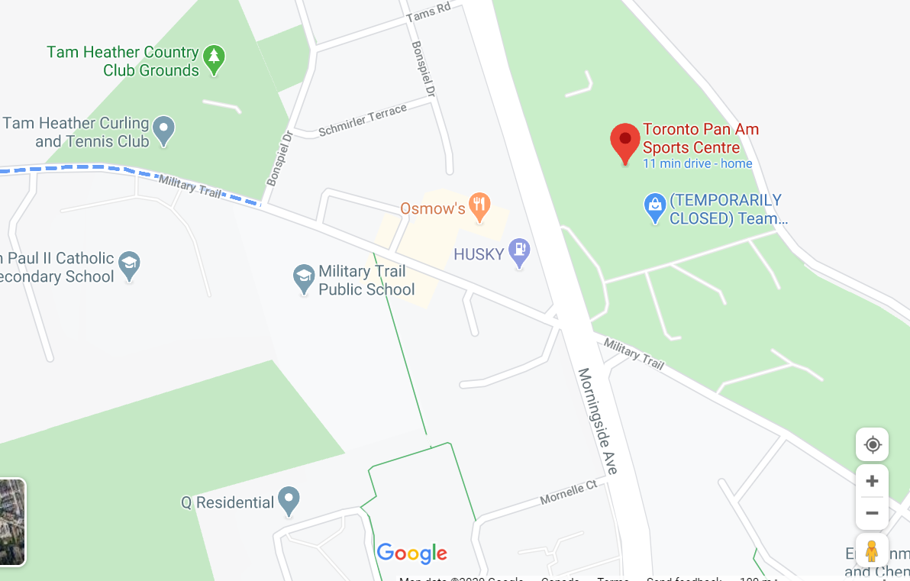
User Feedback
August 6, 2020
 | Average Score (out of 10)
Likeliness to recommend to family/friends | 8.33
Ease of use | 8.5
Usefulness | 8.66
Likely to use | 8.74
6 participants
Notes:
After pilot testing, we asked our testers for their feedback on our system and app idea. This table summarizes the main insights we’ve received. As you can see, from our 6 participants of the final prototype, we received an average score of roughly 85% for the participants likeliness to recommend to family/friends, how easy they found the app to use, how useful they said they found this app, and how likely they are to use this app again.

Slide 17
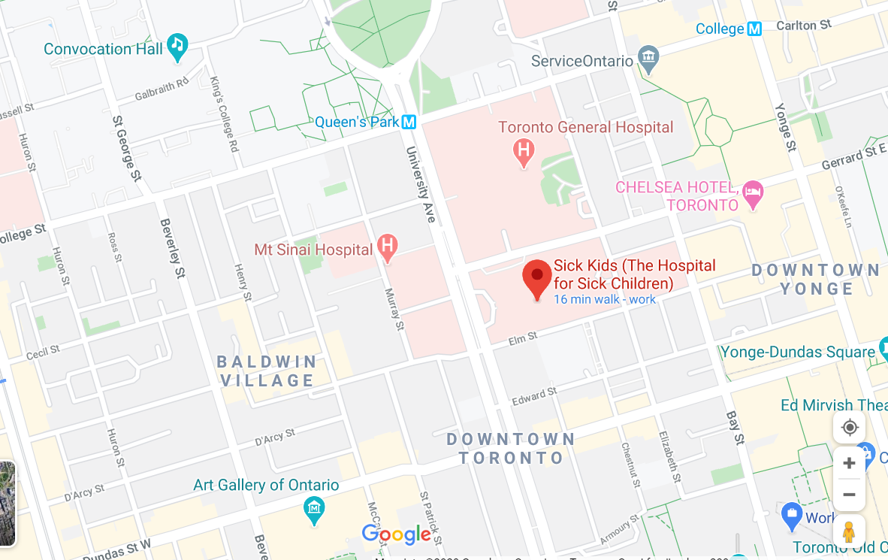
What Problems Does our System Solve?
August 6, 2020
Providing users with real time data
Display medical centres best suited to user’s needs
Directing to those clinics
Notes:
From our research, it was evident that wait times are the biggest issue regarding access to health care. Our system tries to solve this problem by providing users with real time wait time and commute time data. We provide a list of these medical centres and allow the users to sort and filter these results. A user can then choose a clinic from this list and see, in real time, directions to the clinic and they also have an option to get an SMS of the directions. So essentially, our system diversifies the patients to different clinics they are not aware of in turn reducing the load factor of the more popular clinics.

Slide 18
Thank you for listening!
Questions? Comments?

